Slide 1
Network Traffic Analysis
Exploring Apache SPOT http://spot.apache.org/

Slide 2
Quick-Links
http://kudu-mk-1.vpc.cloudera.com:8888/

Slide 3
What is Apache SPOT?
Formerly known as ONI
Initiative of Cloudera, Intel, and partners
Focus on Cybersecurity
Common data formats for advanced analytics
Reliable and robust data (ingestion) pipelines
Repeatable and reliable analysis and modeling procedures

Slide 4
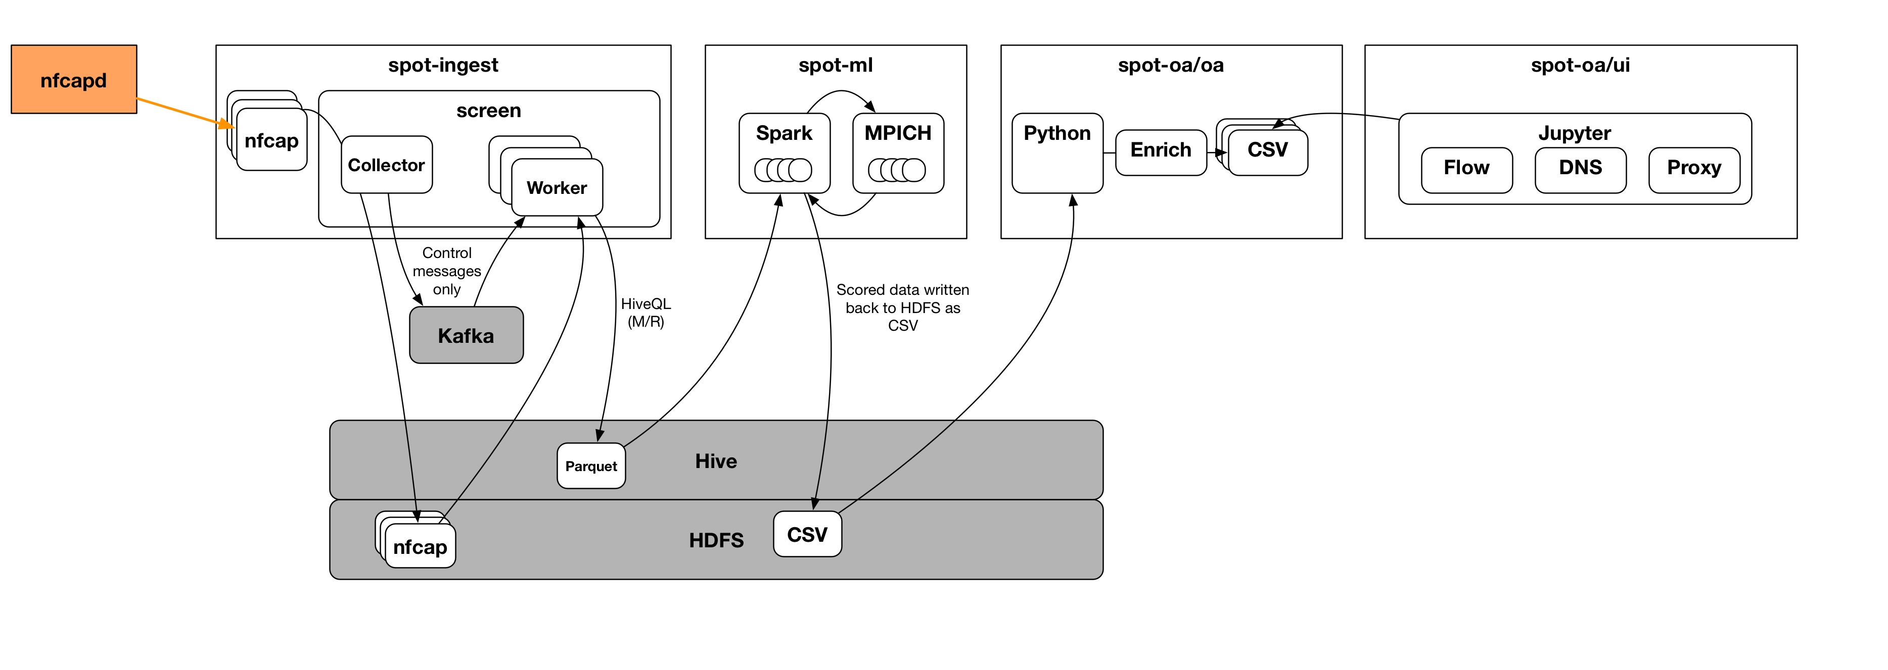
ONI-Data Ingestion
Details have been investigated by application team

Slide 5
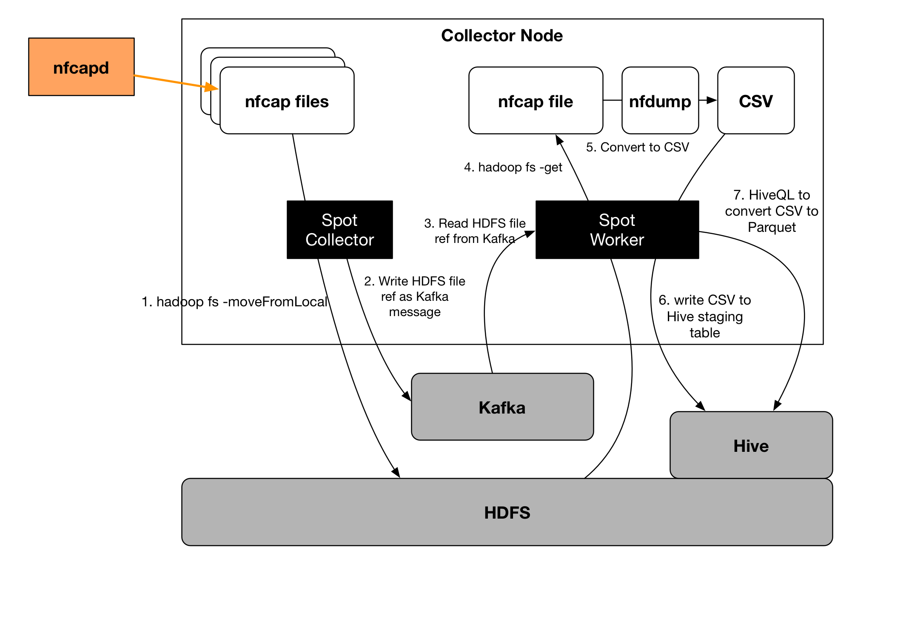
ONI-Data Ingestion

Slide 6
ONI-ML
Implementation of LDA algorithm on 3 data sources:
PROXY
DNS
NETFLOW

Slide 7
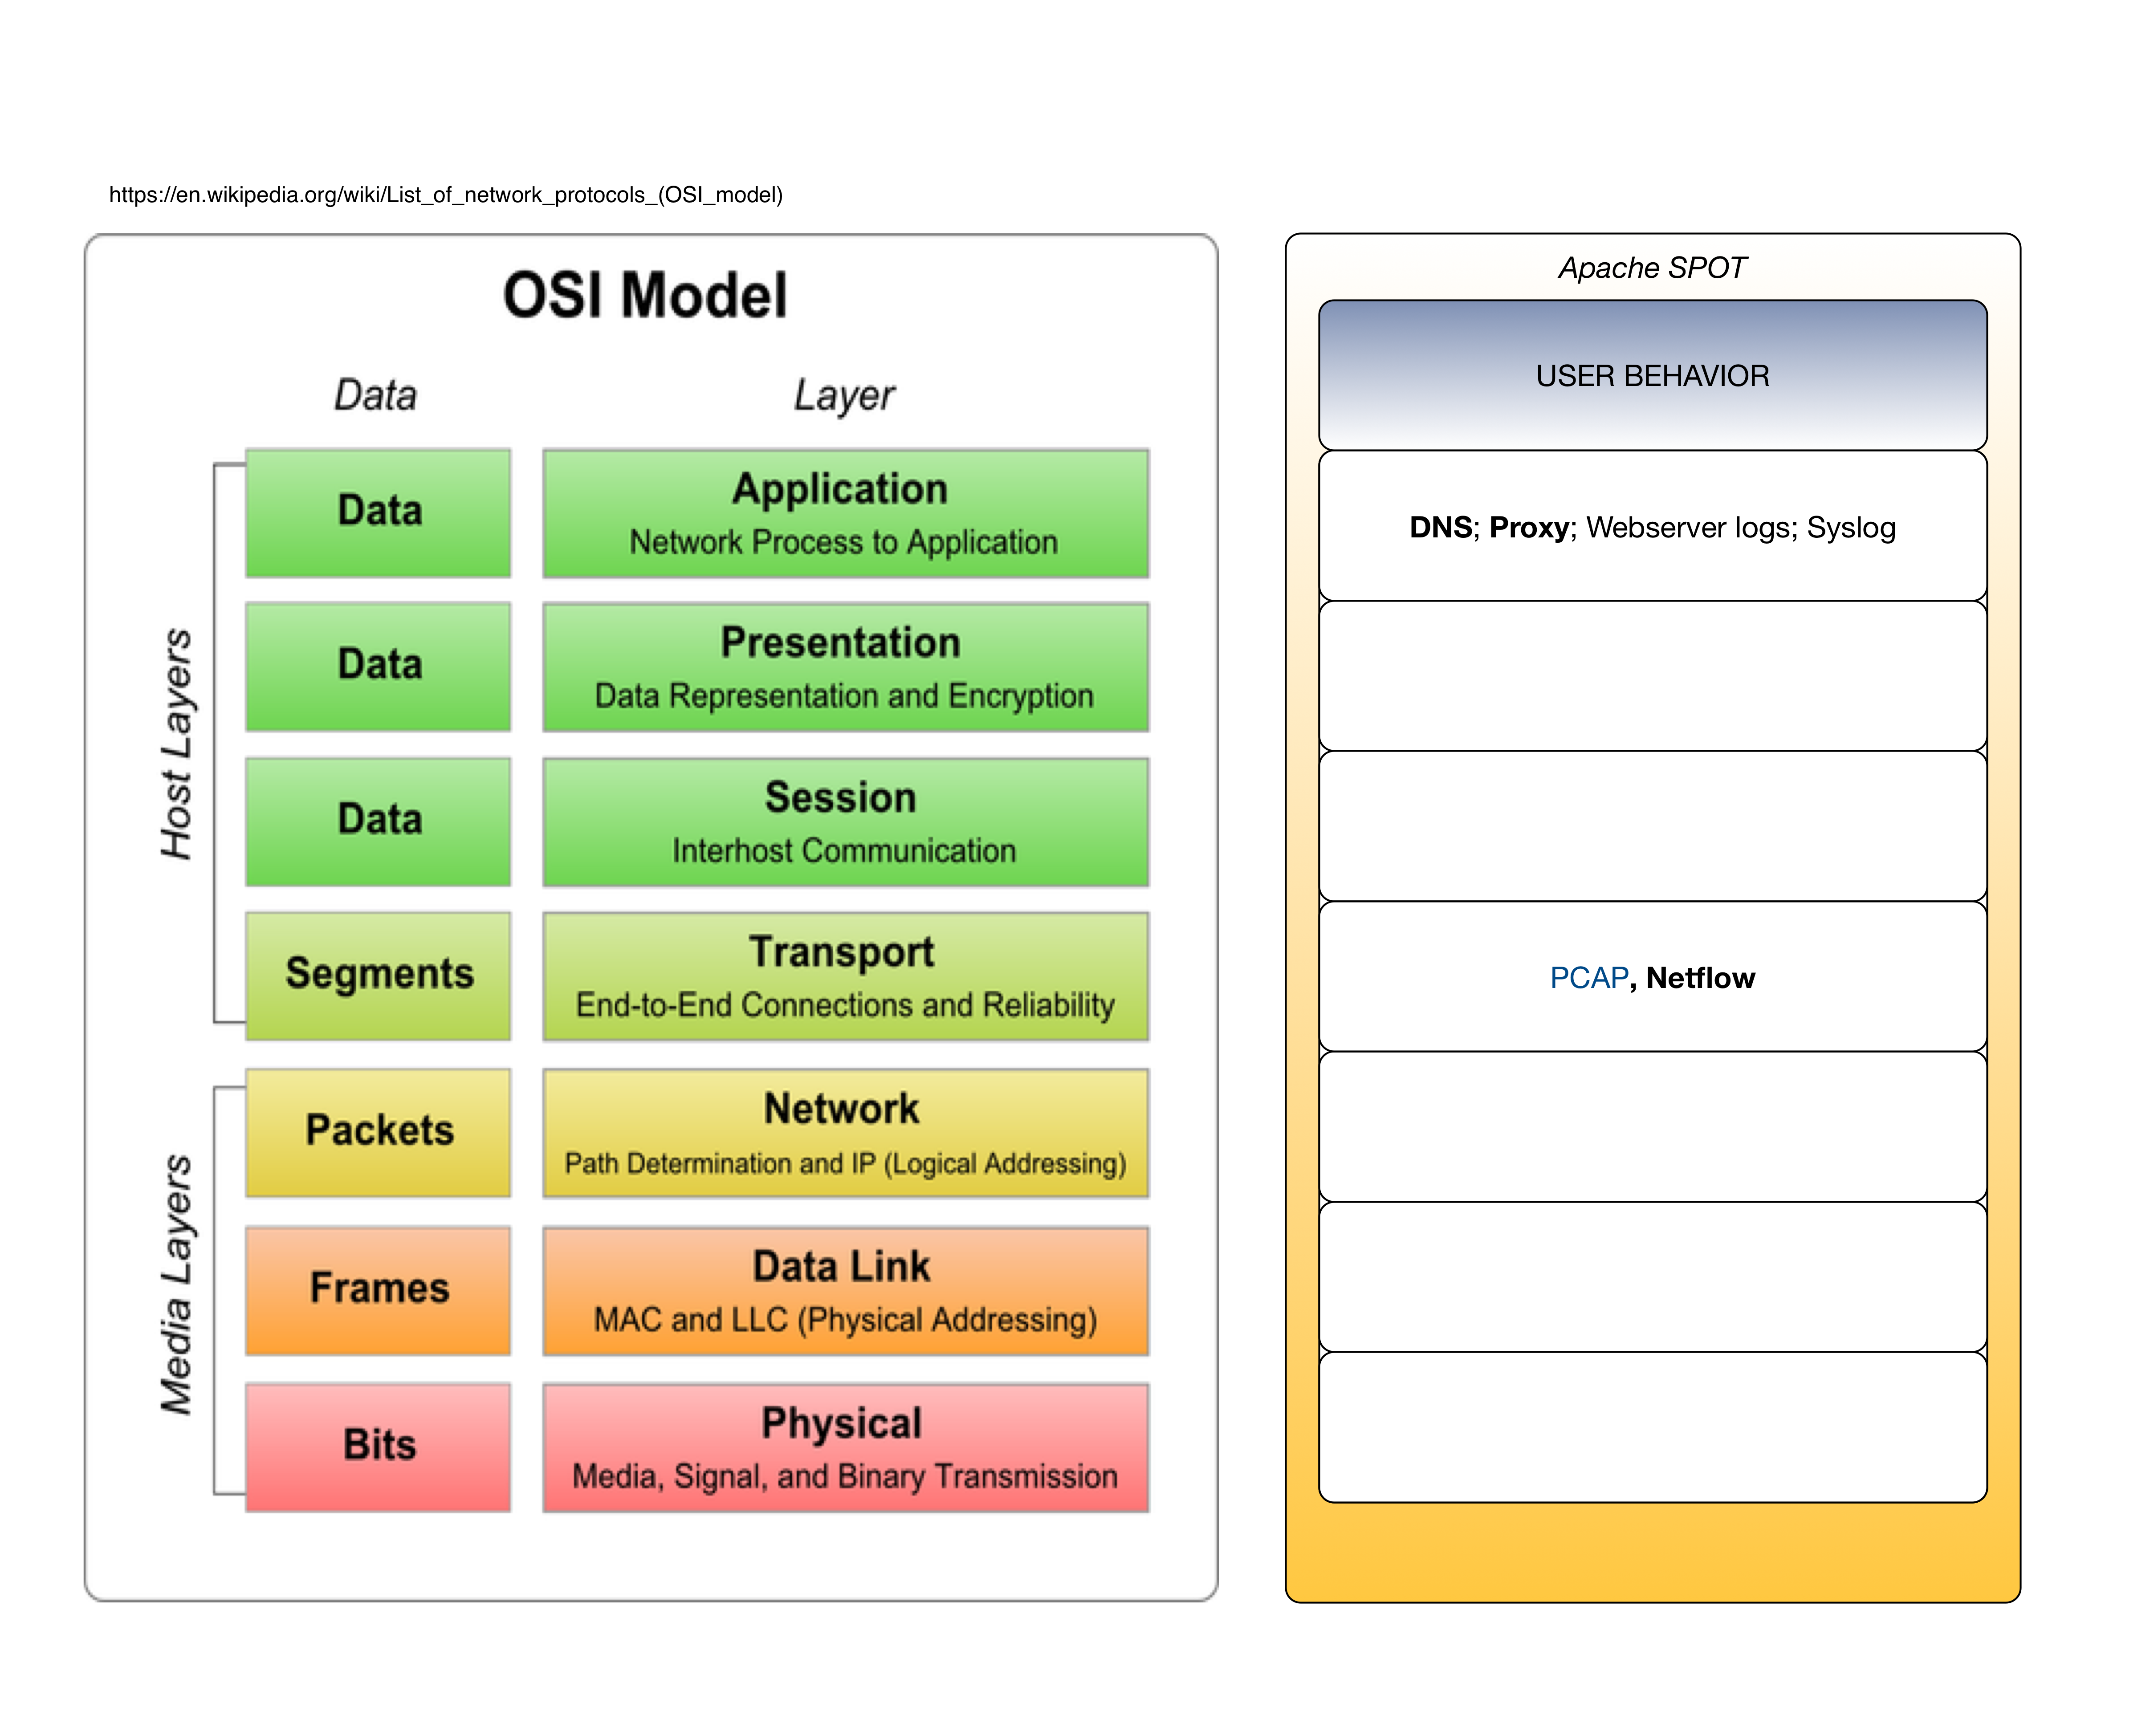

Slide 8
The Data Formats (1) : DNS

Slide 9
The Data Formats (2) : PROXY

Slide 10
The Data Formats (3) : NETFLOW

Slide 11
LDA: What and Why?
Notes:
http://images.google.de/imgres?imgurl=http%3A%2F%2Fsalsahpc.indiana.edu%2Fb649proj%2Fimages%2Fproj3_LDA%2520structure.png&imgrefurl=http%3A%2F%2Fsalsahpc.indiana.edu%2Fb649proj%2Fproj3.html&h=369&w=640&tbnid=uZk8jT2V5g1fjM%3A&vet=1&docid=HxGnFPEpCIFArM&ei=ShptWM7gKceYjwPX16mICQ&tbm=isch&iact=rc&uact=3&dur=7&page=0&start=0&ndsp=28&ved=0ahUKEwjOrbiz7KjRAhVHzGMKHddrCpEQMwgnKA0wDQ&bih=772&biw=1916

Slide 12
LDA: What and Why?

Slide 13
What is wrong with that?
Content inspection is expensive
Analysis becomes language and content specific
Only the overall content, but not the temporal patterns, are taken into account
Topic-Models only reflect information which have been seen during training
Topic-Models are static, real data is dynamic: CONFLICT

Slide 14
Our Goals (long term):
Use communication context information instead of just single package data.
(A) Temporal communication networks
(B) Vectorization of measured traffic data + clustering (OPEN TASK)
Consider additional communication layers:
Syslog data
Webserver logs
Cloudera Manager events
Cloudera Navigator events

Slide 15
Our Activities
Implement data pipelines:
Kafka => Spark => HDFS => Notebook
Kafka => Spark => Kudu
Kudu => Spark => HDFS => (Notebook)
Create reference data sets
Scenario A: Terragen, Terrasort (Huge Batch-Workload)
Scenario B: HDFS PUT,GET; HUE (Interactive Workload)
Scenario C: Idle cluster (Vacation time)
Scenario D: Kafka => Spark => Kudu (Realistic production Workload)
Scenario E: Twitter => Spark => Kudu (Realistic production Workload)

Slide 16
Results

Slide 17
Scenario A:
TERRAGEN
TERRASORT

Slide 18
Test Data for Scenario B:
KDD Cup data set (see Sean's Book - chap.5) in:
node: kudu-mk-5.vpc.cloudera.com path: /root/kddcup.data
Downloaded from: http://kdd.ics.uci.edu/databases/kddcup99/kddcup99.html

Slide 19
Test Data for Scenario C:

Slide 20
Scenario E:
IDLE CLUSTER (with some suspicious activity in the background)

Slide 21
Your Guess???

Slide 22
Our Approach:
Using Snaffer we ingest PCAP data on all nodes in a consistent way
Define cluster-wide unique capture-episodes
Start and stop capture process with timer
Store PCAP data in AVRO format
Create a HIVE table
Create the temporal communication network, using HiveQL
Import data into Gephi to draw the graph

Slide 23
- Collect events
- Create communication network
- Analyze communication network

Slide 24
Packets are events
Grouping in Hive gives networks

Slide 25
Download as CSV using headers,
which fit to Gephi

Slide 26
General Notes on Event Processing:
Kafka gives an order only within a partition
Post-processing in Spark required
HBase sorts rows by key
Table design is now strictly time related, which is not a very universal approach.
Kudu uses Primary Keys Each Kudu table must declare a primary key comprised of one or more columns. Primary key columns must be non-nullable, and may not be a boolean or floating-point type. Every row in a table must have a unique set of values for its primary key columns. As with a traditional RDBMS, primary key selection is critical to ensuring performant database operations. But: Events have timestamps which are not really unique !!! Solution: Primary key includes sensor-id, metric-id, timestamp

Slide 27
Further Analysis
Time evolution of the network properties
Topology
Topological node properties
Entropy of Temporal Network
https://arxiv.org/pdf/1307.5675v1.pdf
Word Shift Graph
Illustrates the model stability over time
https://figshare.com/articles/_A_word_shift_graph_comparing_the_happiness_of_tweets_containing_the_word_8220_climate_8221_to_unfiltered_tweets_/1515618

Slide 28
Further Engineering (1)
Kafka Setup
Since auto—topic generation is not recommended:
Which topics do we need?
SNAProfiler
SQL for Network creation
Topology-inspection per time slice
Use the “Envelop” library:
Allows us to hook in the SNAProfiler component as a JAR.

Slide 29
Further Engineering (2)
Integrate more data sources according to inspection methods
Define AVRO and SOLR schema
Implement automatic dataset initalization / validation
Time Slice Preparation
Complementary to TIMESERIES presentation
KAFKA => HBase
App—controled time slice management:
(K,V) : (EXP_METRIC_TS, NETWORKDATA_as_edgelist)

Slide 31
Milestone One:
Follow a common DSP model (data science process model)
Use CDH default tools and gain experience
Work with Kafka (for input) and Hive tables (for input and output)
Implement a dataset profiling procedure, using Spark
Present results, using Jupiter notebook
Increase functionality and knowledge by doing small iterations
Share code and knowledge

Slide 32
Our Results:
We organized our work in 4 phases:
Data and domain inspection + solution proposals
Environment setup
Tool centric: Jupyter, Eclipse, IntlliJ, CloudCat cluster, Git repository
Data centric:, Data collector tool, Demo data generation, Data formats
Data capturing and data generation
Analyzing the data in a well defined environment
Dev-Results are available in Git repos:
https://github.mtv.cloudera.com/kamir/Snaffer
https://github.com/mbalassi/packet-inspector
Increased functionality and knowledge by doing small iterations
Shared code and knowledge

Slide 33
References
https://docs.google.com/document/d/12SHvTGJWtewk8CpUClOy22mh7cUow18F_Jg2ZNNE3h8/edit#heading=h.r4wlzr2ctack
https://docs.google.com/document/d/1sD0_T2fQ7J5k7Ttx1vmAkYkMljMySgKFimm4hNVXxgA/edit#
http://research.ijcaonline.org/volume74/number17/pxc3890233.pdf
https://www.cs.princeton.edu/~blei/papers/BleiNgJordan2003.pdf

